Slide 1
Preparation and Guideline for Lab 5
Week 10
Dr. Farshid Keivanian

Slide 2
Preparation and Guideline for Lab 5
This PowerPoint is an optional guide designed to support your understanding of the official Lab 5 instructions. It includes step-by-step guidance for selected tasks.
Please follow the official Lab instructions and assessment requirements on Canvas when completing and submitting your work.

Slide 3
Preparation and Guideline for Lab 5
What are we building today?
A multi-router Wide Area Network (WAN) connecting two remote office networks.
A network using 3 Cisco routers, 2 switches and 2 PCs in Cisco Packet Tracer.
An EIGRP-based routing environment for communication between different networks.
A practical troubleshooting scenario to identify, diagnose and resolve network connectivity failures.

Slide 4
Preparation and Guideline for Lab 5
Subtitle: Building, testing and troubleshooting a multi-router enterprise network
By the end of this lab, you will understand how devices communicate across different networks, how routers select paths and how network engineers identify and resolve connectivity failures.
Today's practical question: A computer can connect to its local router but cannot reach a computer in another office. How can we determine where the problem is?

Slide 5
Preparation and Guideline for Lab 5
Learning Outcomes
After completing Lab 5, you should be able to:
Build a multi-router WAN topology in Cisco Packet Tracer.
Configure IPv4 addresses, subnet masks and default gateways.
Configure EIGRP to exchange routing information.
Use ping to test connectivity and packet loss.

Slide 6
Preparation and Guideline for Lab 5
Use tracert and traceroute to identify network paths.
Use Cisco IOS commands to locate incorrect configurations.
Repair network faults and verify restored connectivity.
Explain troubleshooting decisions using command-output evidence.

Slide 7
Preparation and Guideline for Lab 5
Task | Description | Delivery
1 | Build the physical network topology | Live demo
2 | Configure PCs and IP addressing | Live demo
3 | Configure routers and EIGRP | Live demo
4 | Configure switches and hostname resolution | Live demo
5 | Verify basic connectivity with ping | Live demo

Slide 8
Preparation and Guideline for Lab 5
Task | Description | Delivery
6 | Investigate extended ping and simulated outages | Independent
7 | Analyse network paths using tracert/traceroute | Independent
8 | Introduce and isolate a network fault | Independent
9 | Repair the fault and verify connectivity | Independent
10 | Complete reflection and technical documentation | Independent
Watch how the first five tasks are completed, understand the reasoning behind each command, and apply the same methods to the remaining five tasks.

Slide 9
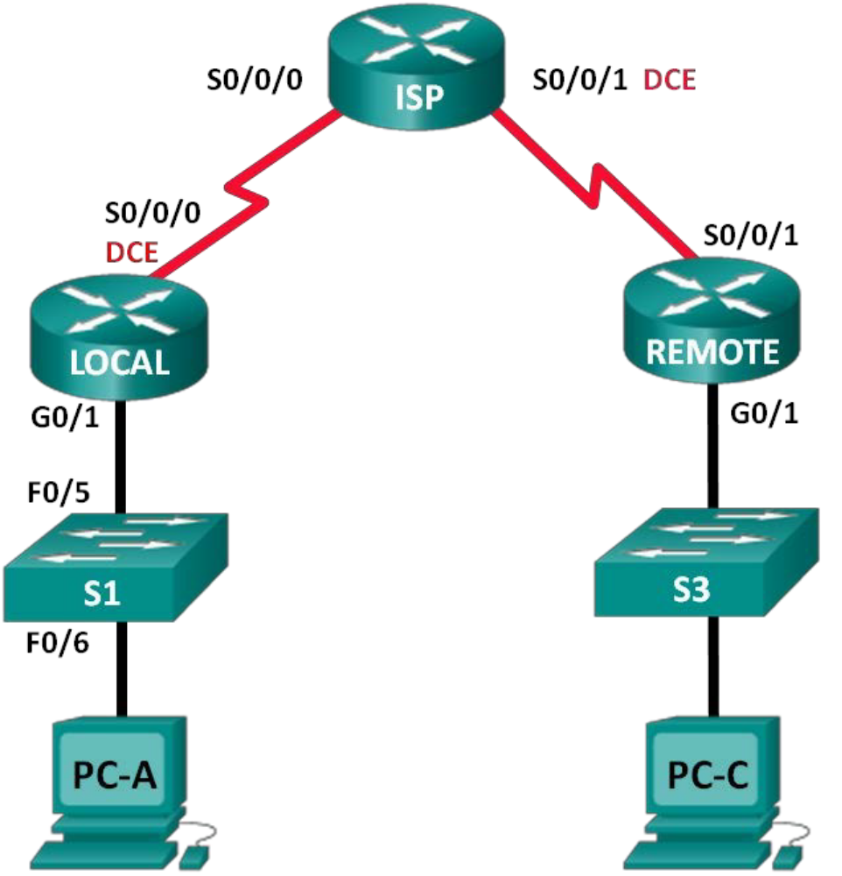
Preparation and Guideline for Lab 5
Understanding the Enterprise Network Topology
PC-A represents a user in the LOCAL office, while PC-C represents a user in the REMOTE office. The ISP router connects these two networks.

Slide 10
Preparation and Guideline for Lab 5
Packets from PC-A to PC-C must pass through LOCAL, ISP and REMOTE before reaching their destination.
Discussion: Why can't PC-A send packets directly to PC-C without using routers?

Slide 11
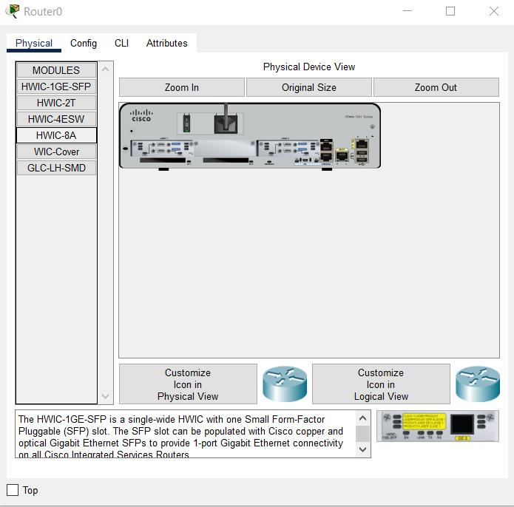
Preparation and Guideline for Lab 5
Equipment and Cable Names in Cisco Packet Tracer
3 × Cisco 1941 Routers
Packet Tracer: Network Devices → Routers → 1941
Rename them LOCAL, ISP and REMOTE. Each requires an HWIC-2T serial module.

Slide 12
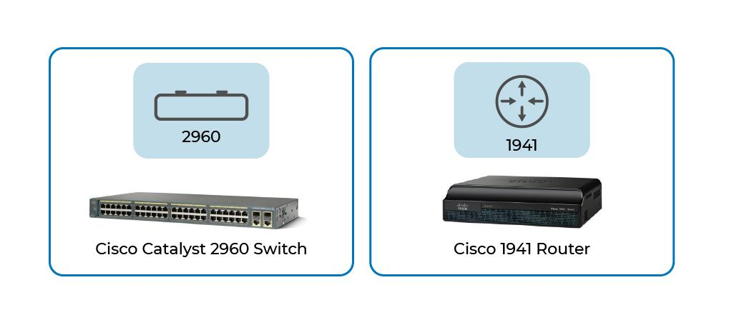
Preparation and Guideline for Lab 5
Equipment and Cable Names in Cisco Packet Tracer
2 × Cisco 2960 Switches
Packet Tracer: Network Devices → Switches → 2960
Rename them S1 and S3.

Slide 13
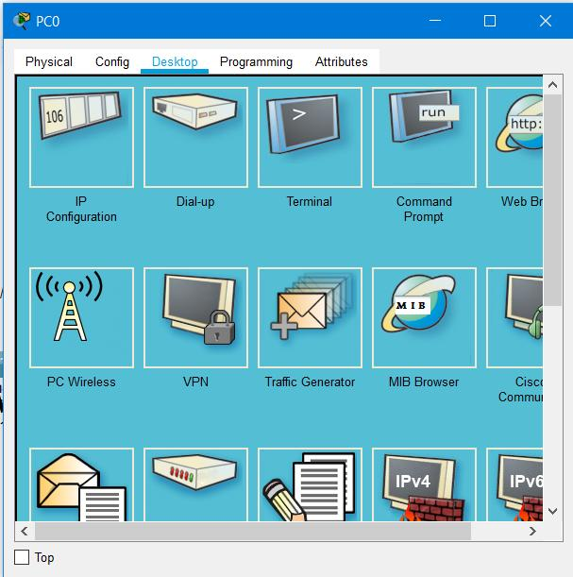
Preparation and Guideline for Lab 5
Equipment and Cable Names in Cisco Packet Tracer
2 × PC-PT Computers
Packet Tracer: End Devices → End Devices → PC
Rename them PC-A and PC-C.
Required cables: Find these under Connections (lightning-bolt icon).

Slide 14
Preparation and Guideline for Lab 5
Equipment and Cable Names in Cisco Packet Tracer
Cable name | Use
Serial DCE | Router-to-router WAN links
Copper Straight-Through | Router-to-switch and switch-to-PC
Console | Optional PC-to-device console configuration
Why: Serial connections simulate WAN links, while copper straight-through cables provide Ethernet connections within the local networks.

Slide 15
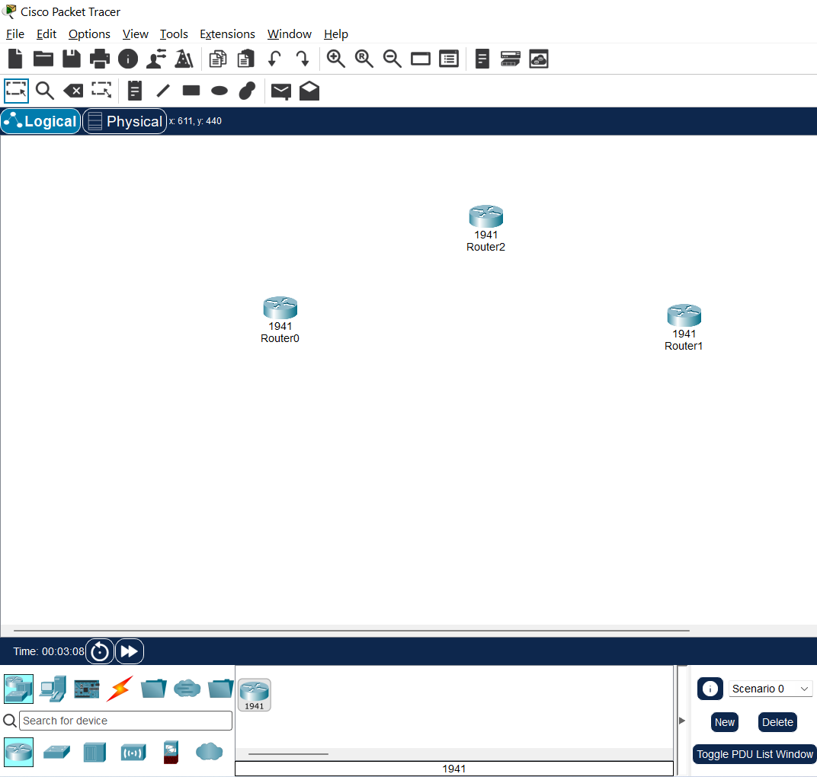
Preparation and Guideline for Lab 5
Instructor demonstration – Tasks 1–5
Task 1: Build the Physical Topology
Live demonstration
Step 1: Drag three 1941 routers into the Logical workspace. Rename them LOCAL, ISP and REMOTE.

Slide 16
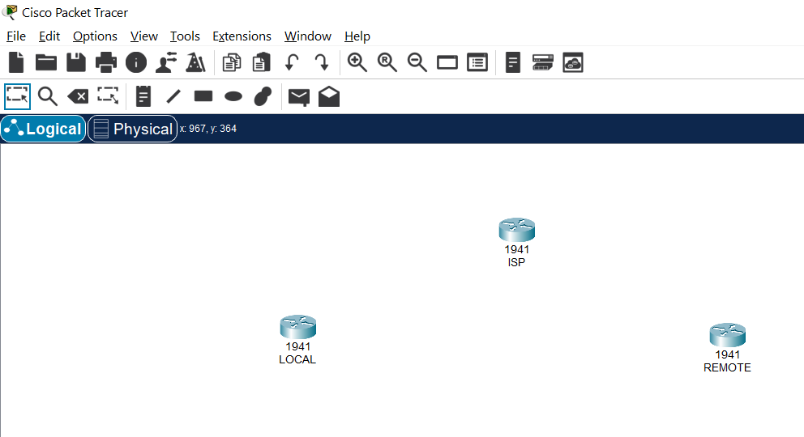
Preparation and Guideline for Lab 5
Instructor demonstration – Tasks 1–5
Task 1: Build the Physical Topology
Live demonstration
Step 1: Drag three 1941 routers into the Logical workspace. Rename them LOCAL, ISP and REMOTE.

Slide 17
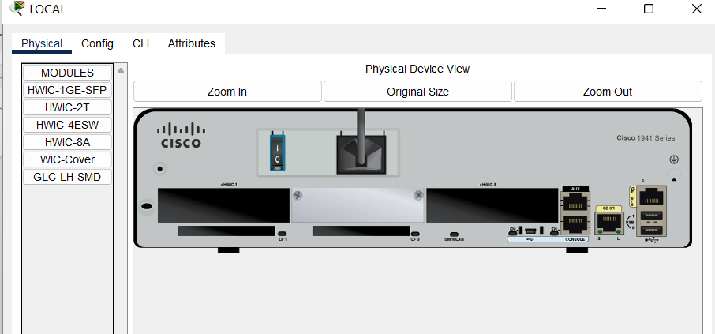
Preparation and Guideline for Lab 5
Instructor demonstration – Tasks 1–5
Step 2: Open each router → Physical → zoom in and switch off power → select HWIC-2T → insert into an available HWIC slot → switch on power.
Step 3: Add two 2960 switches, S1 and S3.
Step 4: Add two PC-PT computers, PC-A and PC-C.

Slide 18
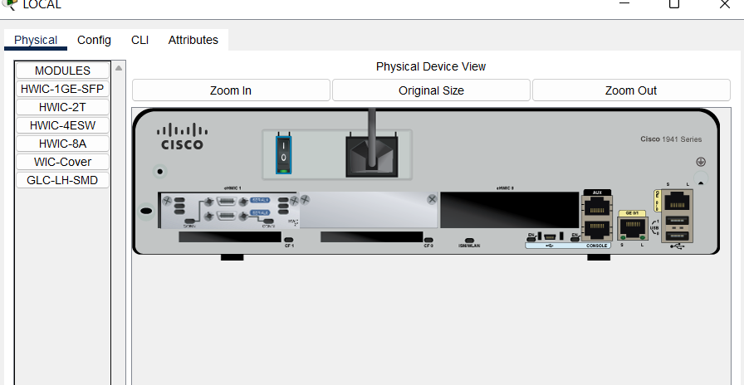
Preparation and Guideline for Lab 5
Instructor demonstration – Tasks 1–5
Step 2: Open each router → Physical → zoom in and switch off power → select HWIC-2T → insert into an available HWIC slot → switch on power.
Step 3: Add two 2960-24TT (third option) switches, S1 and S3.
Step 4: Add two PC-PT
computers, PC-A and PC-C.

Slide 19
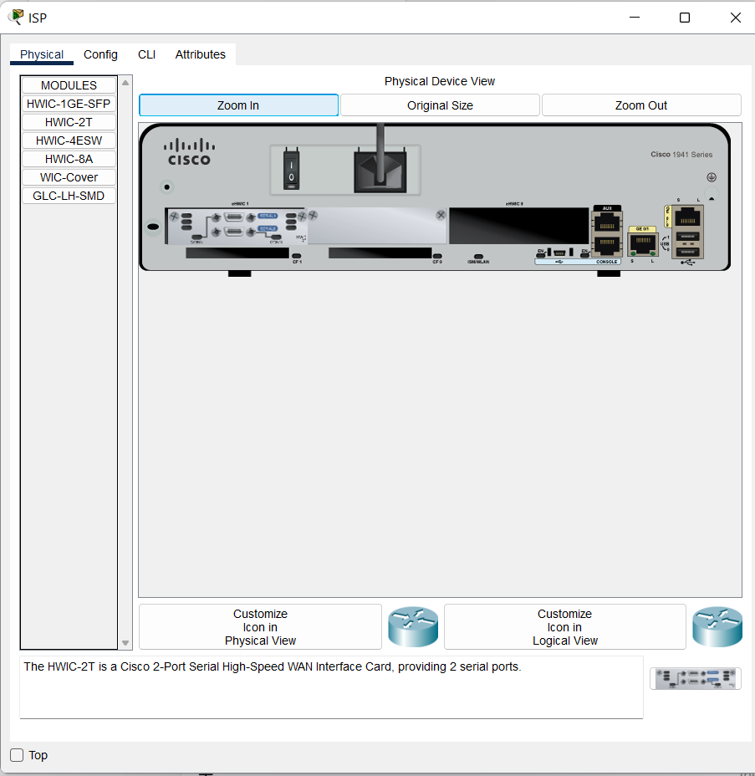
Preparation and Guideline for Lab 5
Instructor demonstration – Tasks 1–5
Repeat for the ISP router.

Slide 20
Preparation and Guideline for Lab 5
Instructor demonstration – Tasks 1–5
Step 5: Connect the devices as follows.
From | To | Cable
LOCAL S0/0/0 (DCE) | ISP S0/0/0 | Serial DCE
ISP S0/0/1 (DCE) | REMOTE S0/0/1 | Serial DCE
LOCAL G0/1 | S1 F0/5 | Copper Straight-Through
S1 F0/6 | PC-A FastEthernet0 | Copper Straight-Through
REMOTE G0/1 | S3 F0/5 | Copper Straight-Through
S3 F0/6 | PC-C FastEthernet0 | Copper Straight-Through

Slide 21
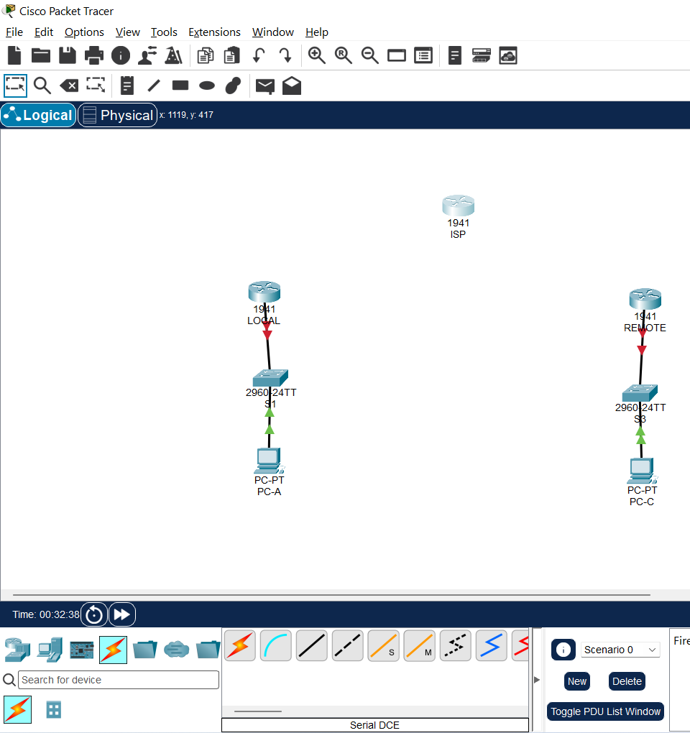
Preparation and Guideline for Lab 5
Instructor demonstration – Tasks 1–5

Slide 22
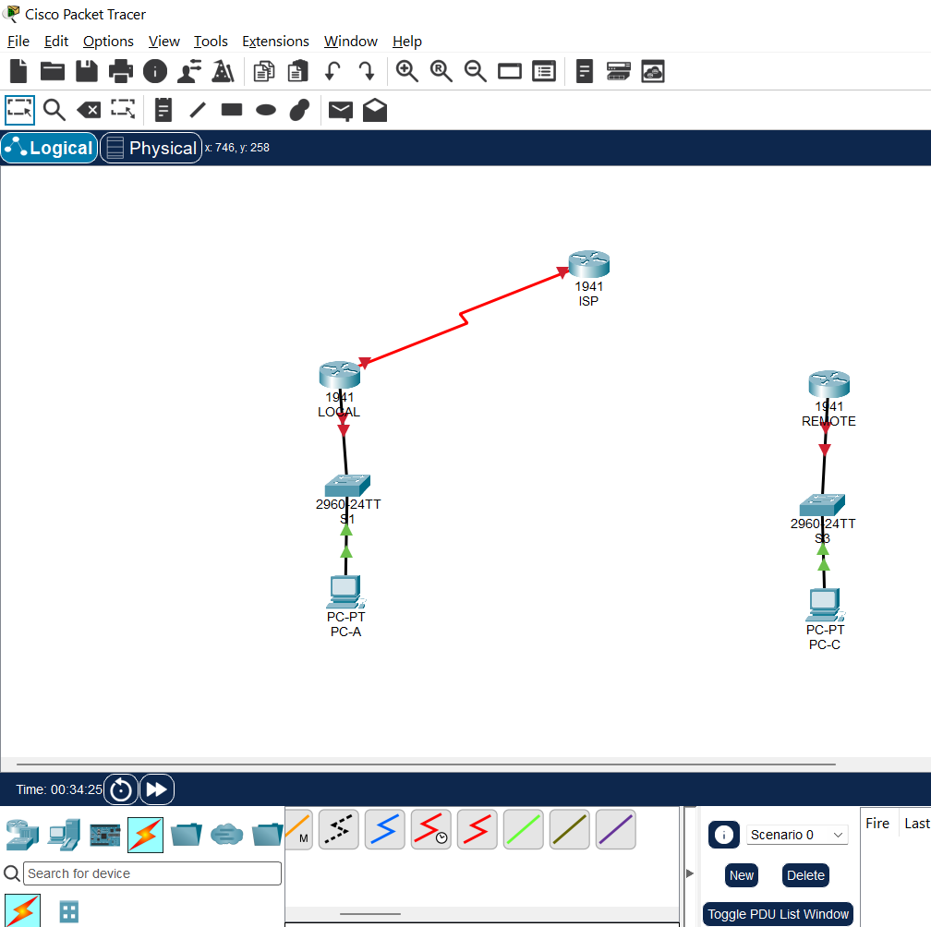
Preparation and Guideline for Lab 5
Instructor demonstration – Tasks 1–5
Select Connections → Serial DCE (red zigzag cable with a clock).
Click LOCAL first and
select Serial0/0/0.
Click ISP and select
Serial0/0/0.

Slide 23
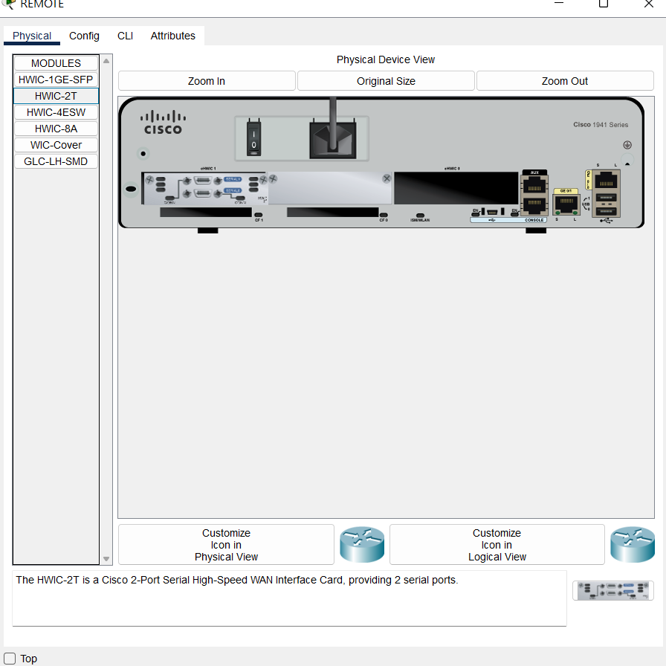
Preparation and Guideline for Lab 5
Instructor demonstration – Tasks 1–5
Open the REMOTE router → Physical tab.
Turn off the router, verify
that the HWIC-2T module
is installed, and turn it
back on.

Slide 24
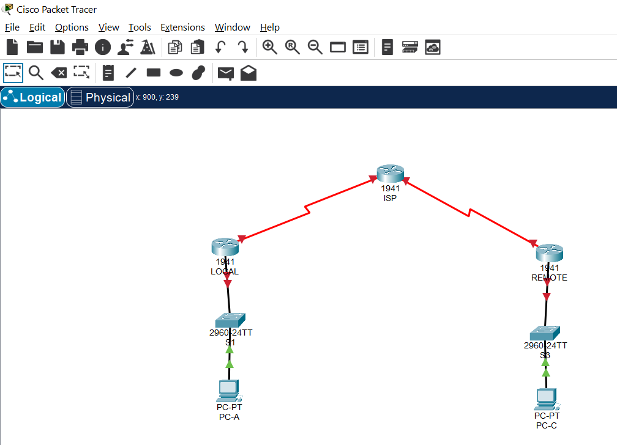
Preparation and Guideline for Lab 5
Instructor demonstration – Tasks 1–5
Return to the Logical workspace.
Select Connections → Serial DCE (red zigzag cable with a clock).
Click ISP first and select Serial0/0/1.
Click REMOTE and select
Serial0/0/1.

Slide 25
Preparation and Guideline for Lab 5
Instructor demonstration – Tasks 1–5
For each serial connection, click the intended DCE router first. Check the actual DCE endpoint if the cable was attached differently.
Why: A router must have an appropriate interface before a serial connection can be established. The DCE end provides the clocking needed for the serial link.
Expected result: Seven devices connected by six cables. Router interfaces may initially be down until configured.

Slide 26
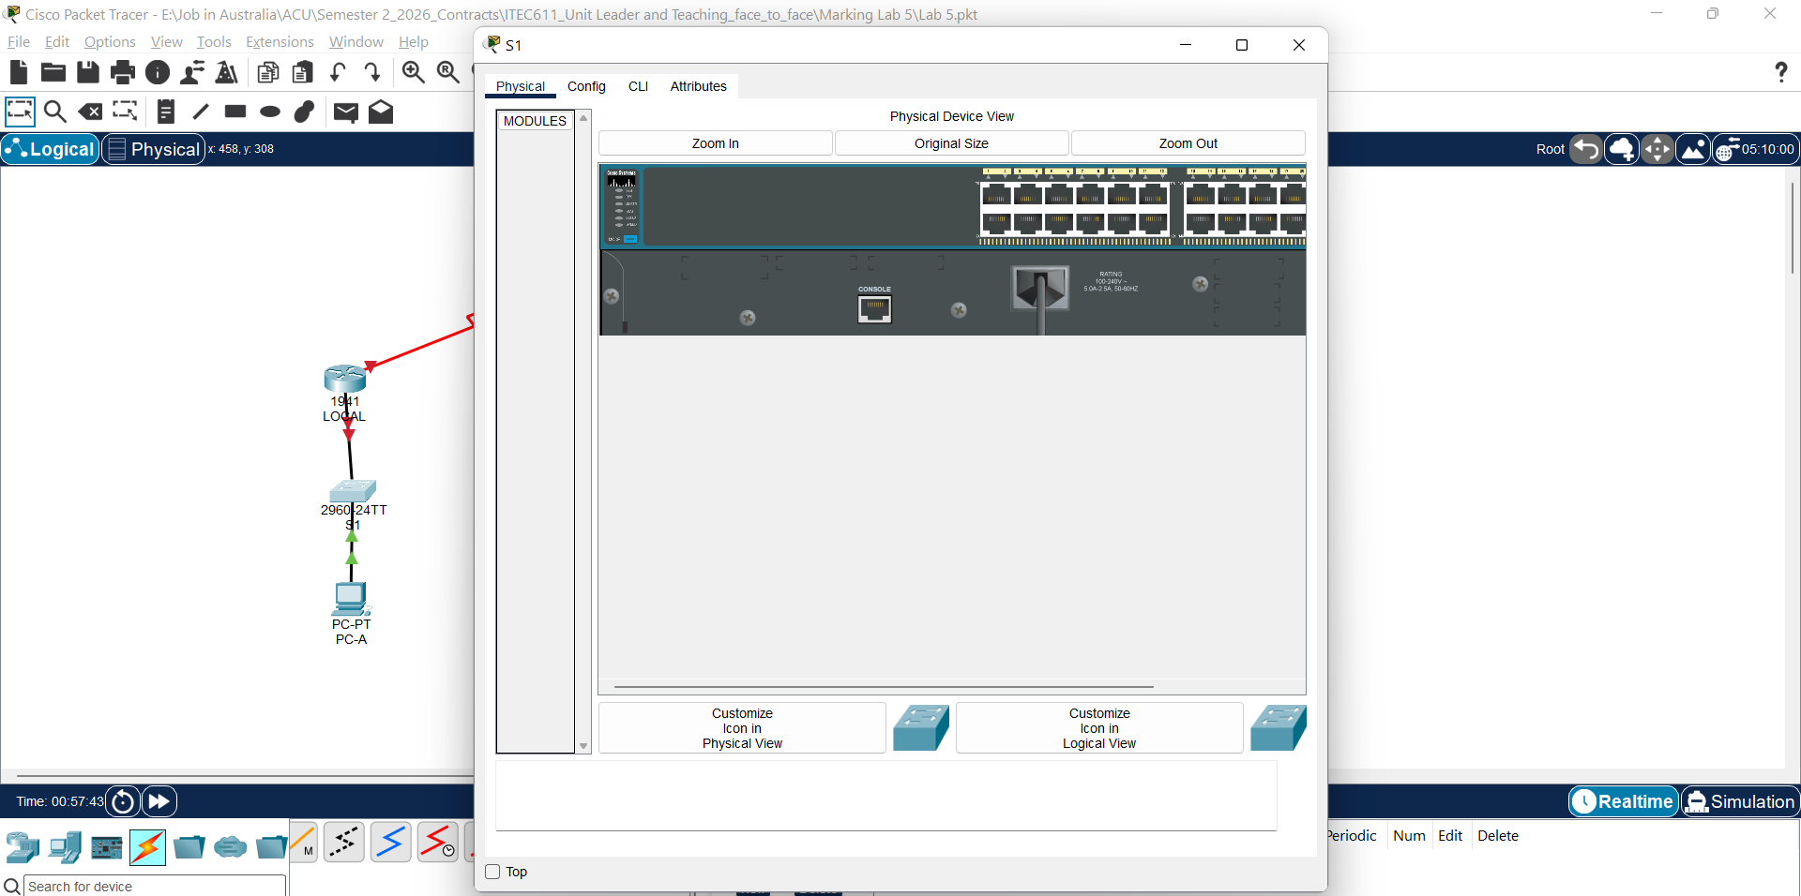
Preparation and Guideline for Lab 5
Instructor demonstration – Tasks 1–5
All devices should be turn on

Slide 27
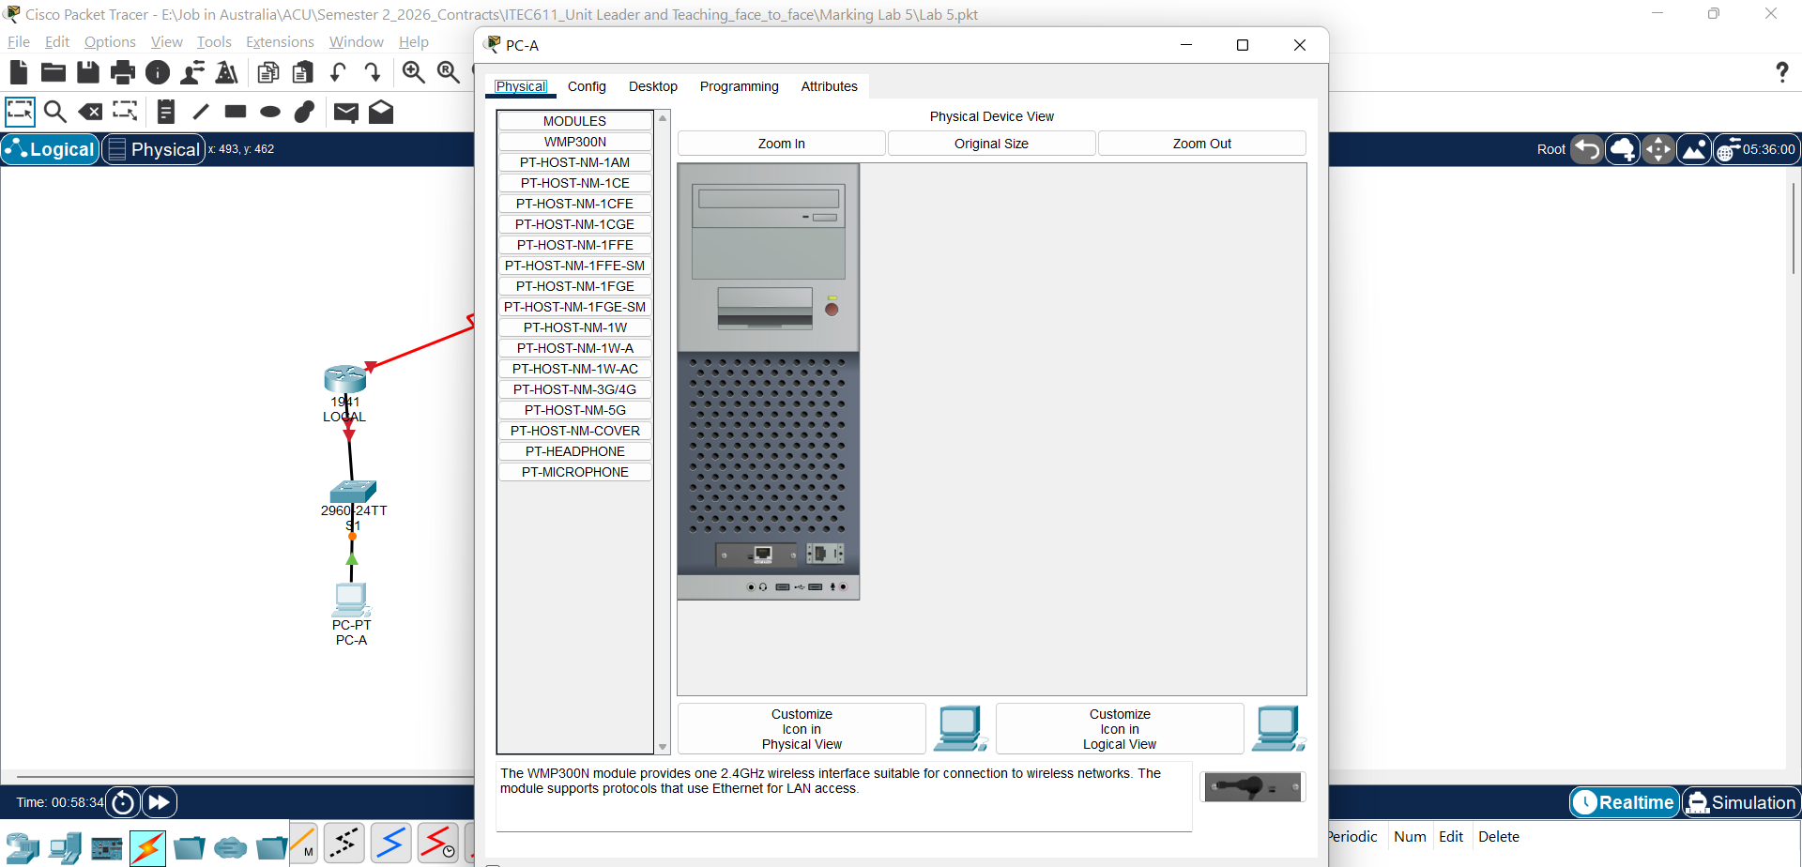
Preparation and Guideline for Lab 5
Instructor demonstration – Tasks 1–5
All devices should be turn on

Slide 28
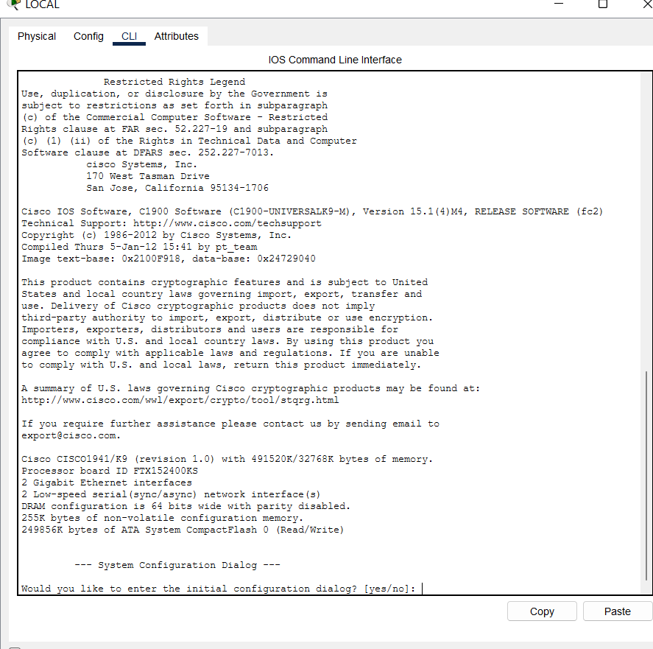
Preparation and Guideline for Lab 5
Task 1: Understanding Serial Clocking
A serial WAN link needs timing information so that devices can exchange bits correctly.
On the LOCAL router:
enable
configure terminal
interface serial 0/0/0
clock rate 56000
no shutdown

Slide 29
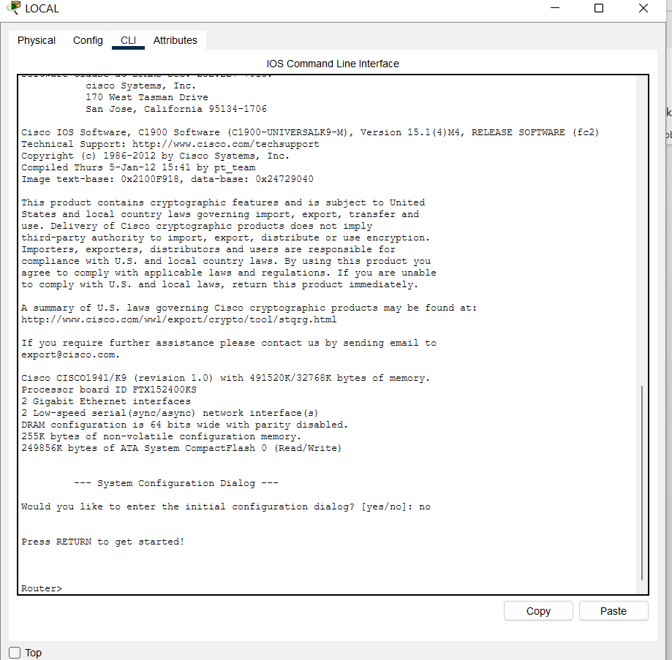
Preparation and Guideline for Lab 5
Configure the LOCAL router
1. Skip the initial configuration dialog
Type:
no
Press Enter.
If you see:
Press RETURN to get started!
Press Enter again.

Slide 30
Preparation and Guideline for Lab 5
You should see:
Router>

Slide 31
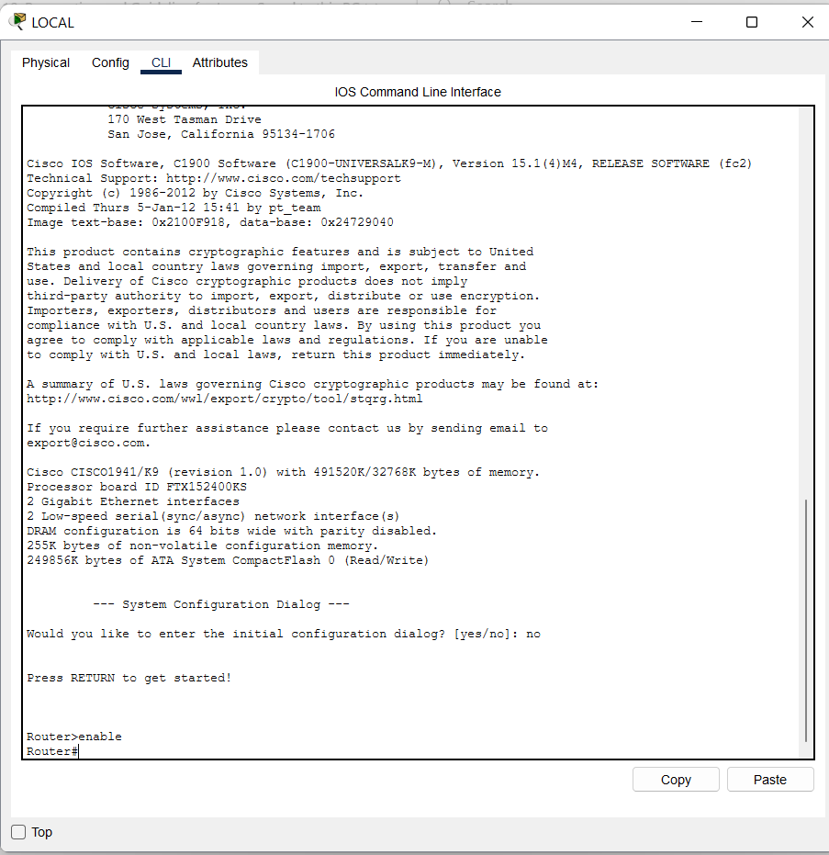
Preparation and Guideline for Lab 5
Enter privileged EXEC mode
Type:
enable
The prompt changes:
Router#
Why? This mode gives you
access to administrative
commands.

Slide 32
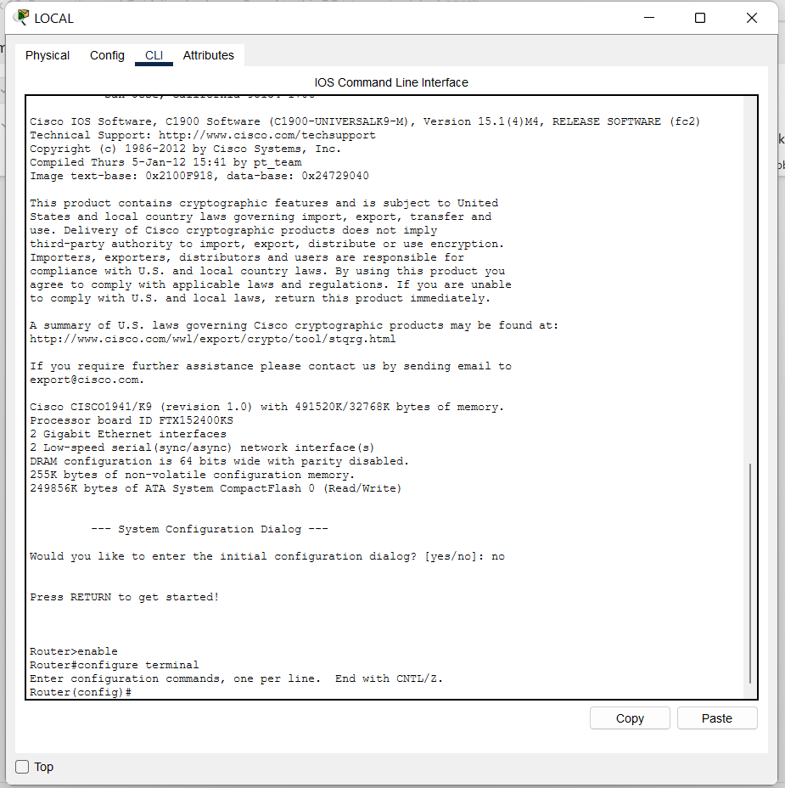
Preparation and Guideline for Lab 5
Enter global configuration mode
Type:
configure terminal
The prompt changes:
Router(config)#
Why? This mode allows
you to change the router
configuration.

Slide 33
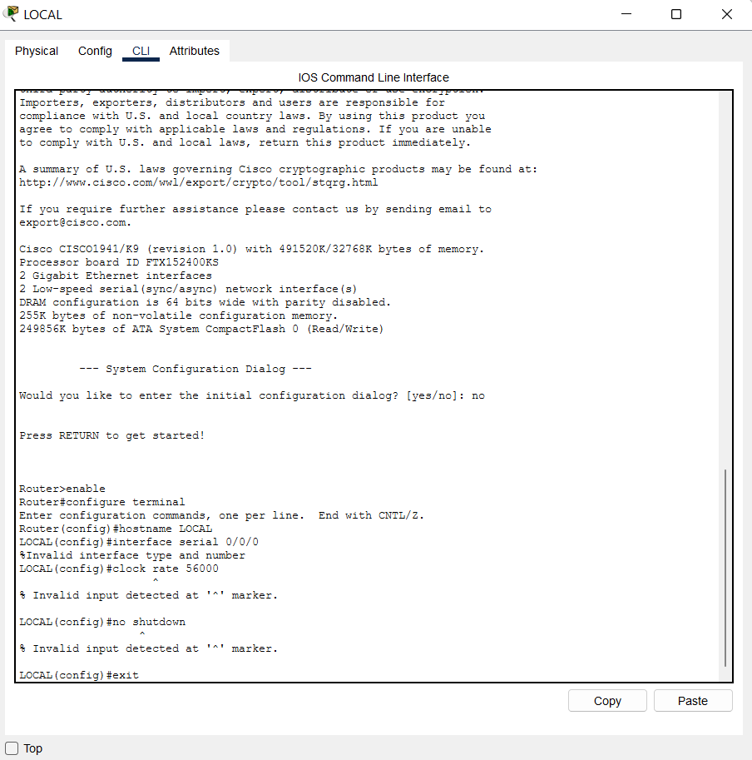
Preparation and Guideline for Lab 5
Configure the serial interface
Enter the following commands one at a time:
hostname LOCAL
interface serial 0/0/0
clock rate 56000
no shutdown
exit
end

Slide 34
Preparation and Guideline for Lab 5
Important: clock rate 56000 should be configured only if LOCAL Serial0/0/0 is the DCE end of the cable connecting LOCAL to ISP.
If Packet Tracer displays an
error indicating that the clock
rate applies only to DCE
interfaces, verify the cable
direction.

Slide 35
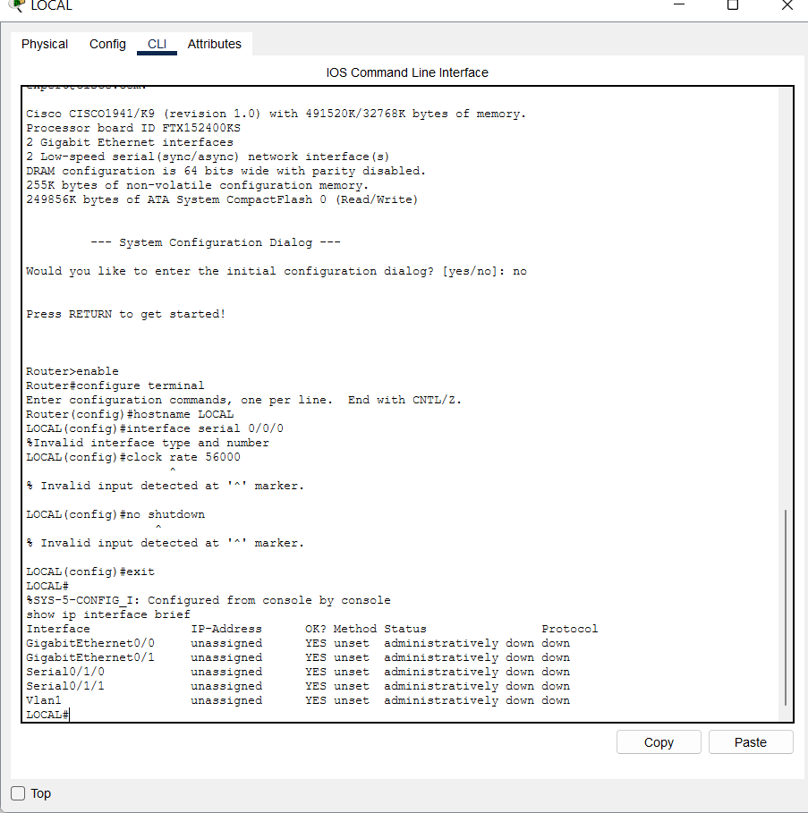
Preparation and Guideline for Lab 5
Verify the configuration
Type: show ip interface brief
You should see Serial0/0/0 in
the interface list.
The interface may not yet show
up/up because the IP address
and other end of the serial
connection still need
configuration.

Slide 36
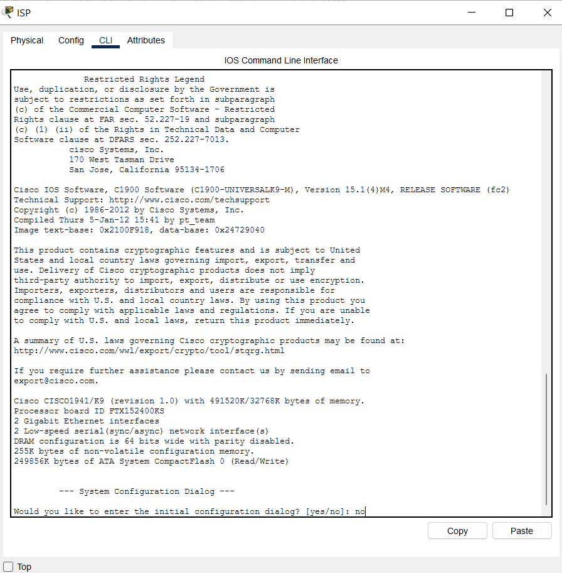
Preparation and Guideline for Lab 5
Configure the ISP router
Now close the LOCAL router window.
Double-click the ISP router at the top of your topology.
Select CLI.
If the initial configuration
dialog appears, type no.
Press Enter until you see
Router>.

Slide 37
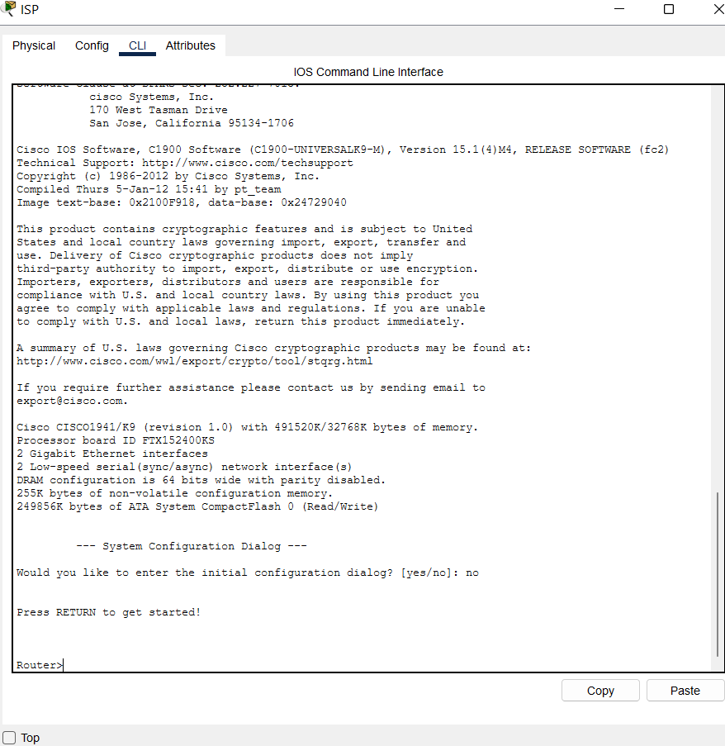
Preparation and Guideline for Lab 5
Configure the ISP router
Now close the LOCAL router window.
Double-click the ISP router at the top of your topology.
Select CLI.
If the initial configuration
dialog appears, type no.
Press Enter until you see
Router>.

Slide 38
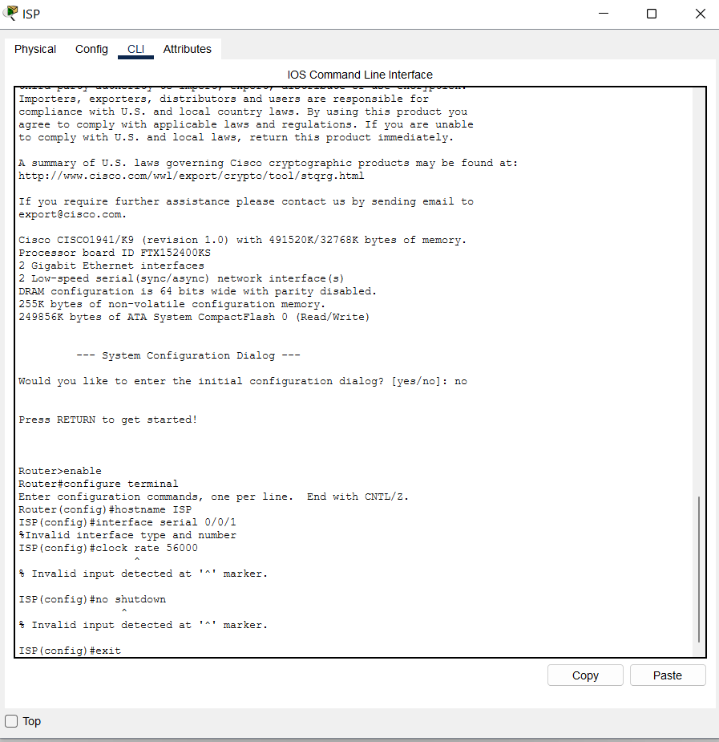
Preparation and Guideline for Lab 5
Enter:
enable
configure terminal
hostname ISP
interface serial 0/0/1
clock rate 56000
no shutdown
exit
end

Slide 39
Preparation and Guideline for Lab 5
Why ISP Serial0/0/1?
Your lab requires the following serial connections:
Connection | DCE side | DTE side
LOCAL ↔ ISP | LOCAL S0/0/0 | ISP S0/0/0
ISP ↔ REMOTE | ISP S0/0/1 | REMOTE S0/0/1
The DCE side supplies clocking, so the clock rate is configured on LOCAL S0/0/0 and ISP S0/0/1.

Slide 40
Preparation and Guideline for Lab 5
Configure IP addresses for both WAN links
Clocking alone does not provide IP connectivity. You also need to assign addresses.
LOCAL router
Open LOCAL → CLI:

Slide 41
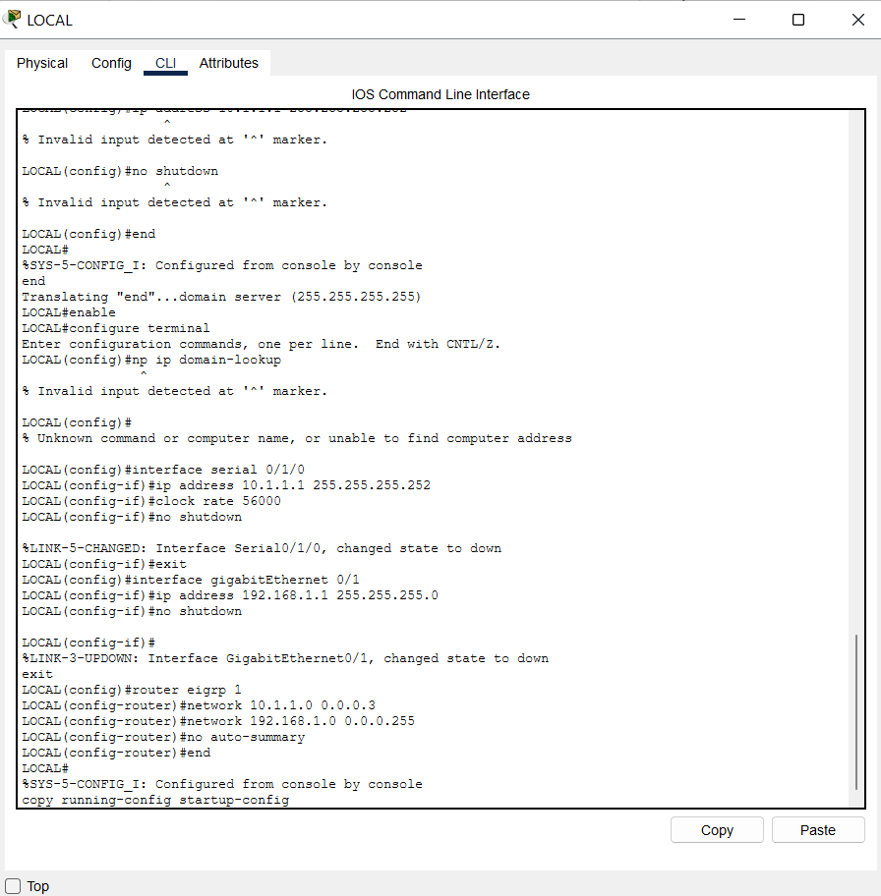
Preparation and Guideline for Lab 5
enable
configure terminal
no ip domain-lookup
interface serial 0/1/0
ip address 10.1.1.1 255.255.255.252
clock rate 56000
no shutdown
exit
interface gigabitEthernet 0/1
ip address 192.168.1.1 255.255.255.0
no shutdown
exit
router eigrp 1
network 10.1.1.0 0.0.0.3
network 192.168.1.0 0.0.0.255
no auto-summary
end
copy running-config startup-config
Important: This assumes LOCAL Serial0/1/0 is the DCE end of the cable. If the clock rate command fails, check the DCE cable direction.

Slide 42
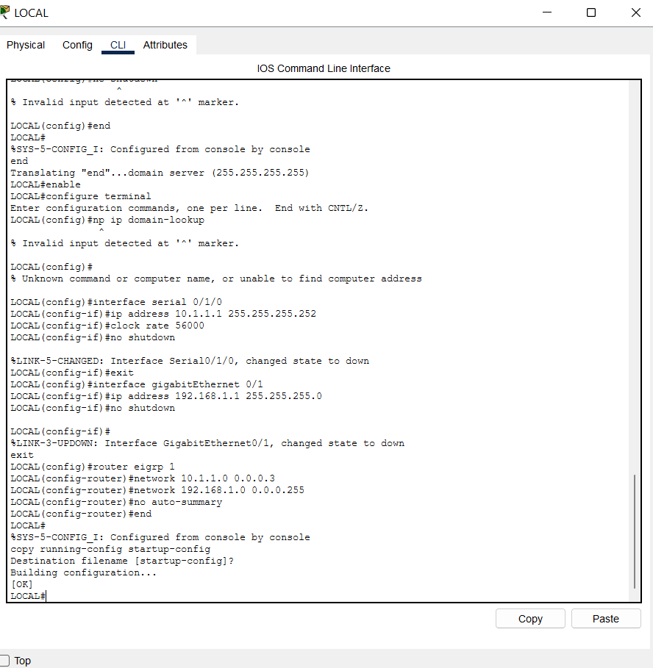
Preparation and Guideline for Lab 5
You are currently at:
Destination filename [startup-config]?
What to enter now
Simply press Enter. Do not type anything.
You should see something similar to:
Building configuration...
[OK]
LOCAL#
This saves your configuration.

Slide 43
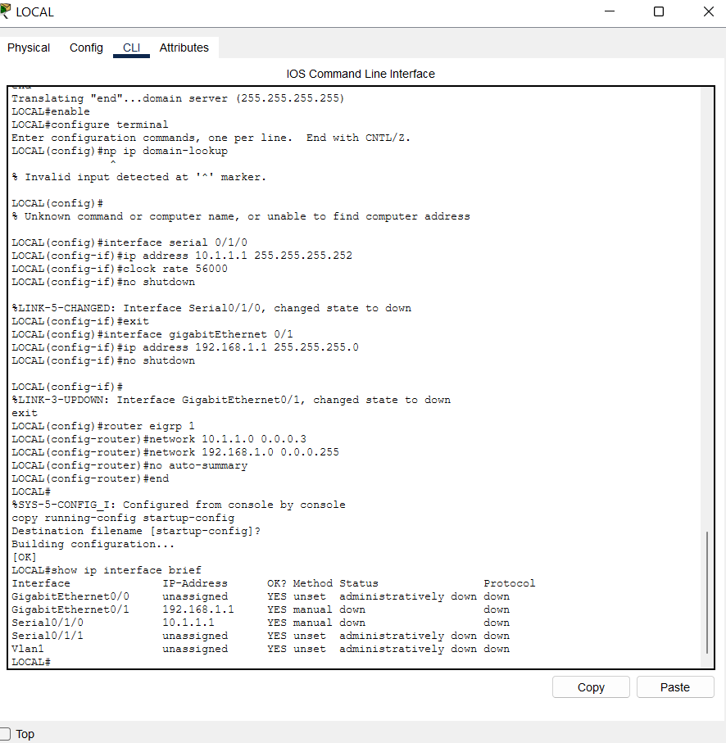
Preparation and Guideline for Lab 5
Interface | IP address | Current status | Result
GigabitEthernet0/1 | 192.168.1.1 | down/down | Check cable to S1
Serial0/1/0 | 10.1.1.1 | down/down | Check cable to ISP
GigabitEthernet0/0 | Unassigned | administratively down/down | Normal — unused
Serial0/1/1 | Unassigned | administratively down/down | Normal — unused

Slide 44
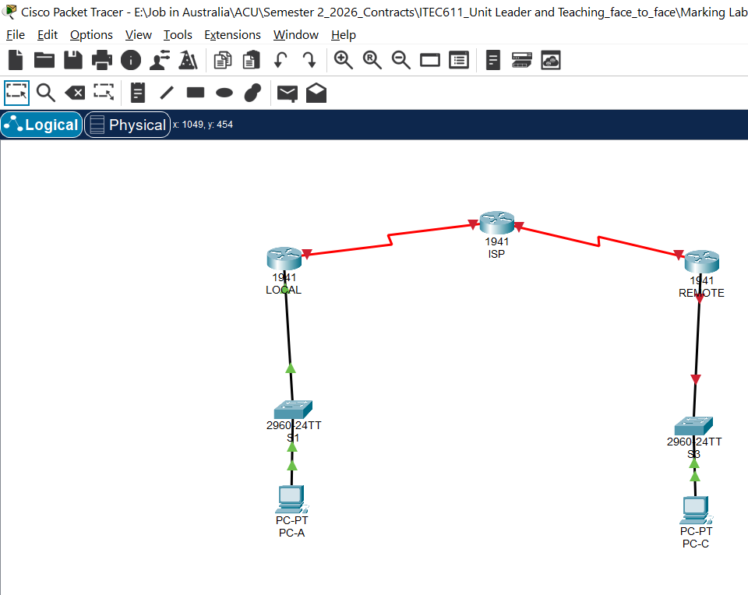
Preparation and Guideline for Lab 5
Fix LOCAL ↔ S1 first
Follow these steps:
Select the Delete tool (X) in Packet Tracer.
Click the black cable connecting LOCAL and S1 to remove it.
Click Connections (lightning icon).
Select Copper Straight-Through (solid black line).
Click LOCAL → select
GigabitEthernet0/1.
Click S1 → select FastEthernet0/5.
Wait a few seconds for the link
indicators to update.

Slide 45
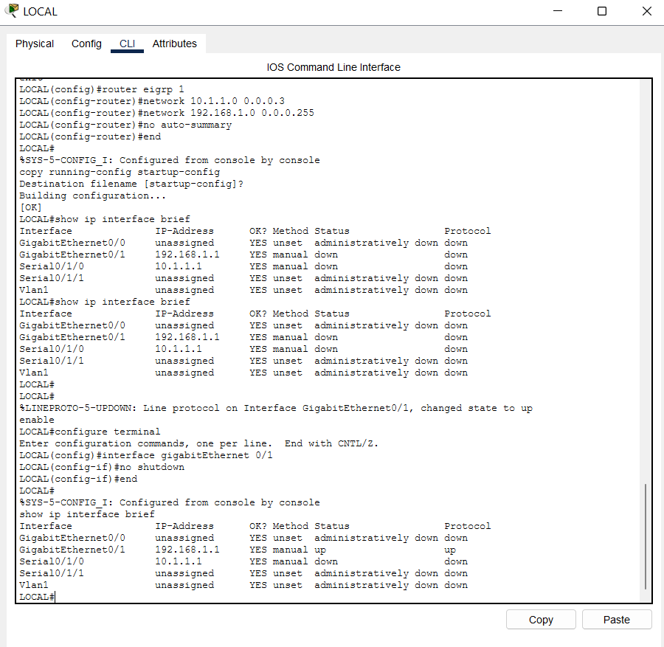
Preparation and Guideline for Lab 5
Then open LOCAL → CLI and enter:
enable
configure terminal
interface gigabitEthernet 0/1
no shutdown
end
show ip interface brief
Expected result:
GigabitEthernet0/1 192.168.1.1 up up
This means the LOCAL router can communicate with the S1 switch at the interface level.

Slide 46
Preparation and Guideline for Lab 5
Fix the LOCAL ↔ ISP serial connection
Your serial interface is:
Serial0/1/0 10.1.1.1 down down
The screenshot shows the DCE clock symbol on LOCAL, which is correct.
You have already configured LOCAL with clock rate 56000, so we should now check ISP.
Open ISP → CLI and enter:
This means the LOCAL router can communicate with the S1 switch at the interface level.

Slide 47
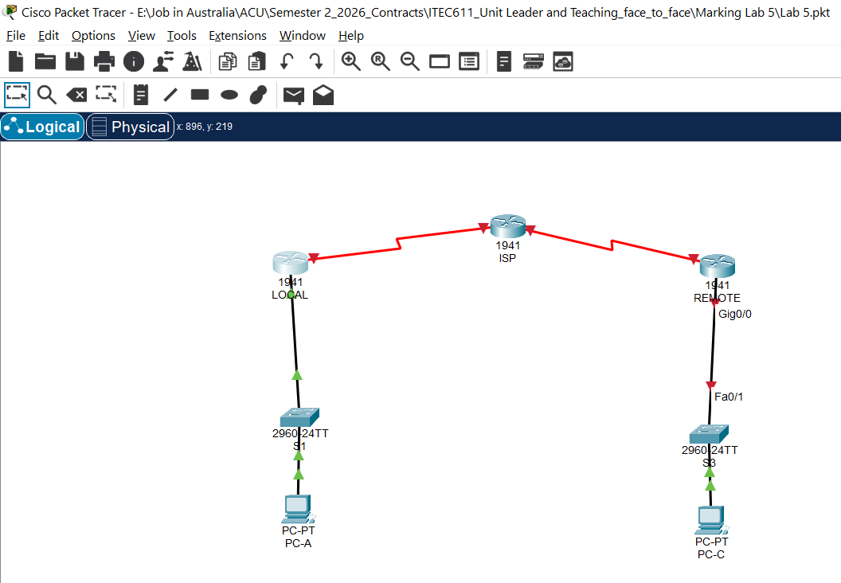
Preparation and Guideline for Lab 5
The screenshot shows that the LOCAL ↔ S1 connection is now green, which is excellent. The right-side connection is still red.
Step 1 – Remove the existing cable
Select the Delete (X) tool from the top toolbar.
Click the black cable connecting REMOTE to S3.
This removes the existing connection.

Slide 48
Preparation and Guideline for Lab 5
Step 2 – Connect REMOTE to S3 correctly
Click Connections (lightning icon).
Select Copper Straight-Through (solid black cable).
Click the REMOTE router.
Select GigabitEthernet0/1 (not GigabitEthernet0/0).
Click the S3 switch.
Select FastEthernet0/1.

Slide 49
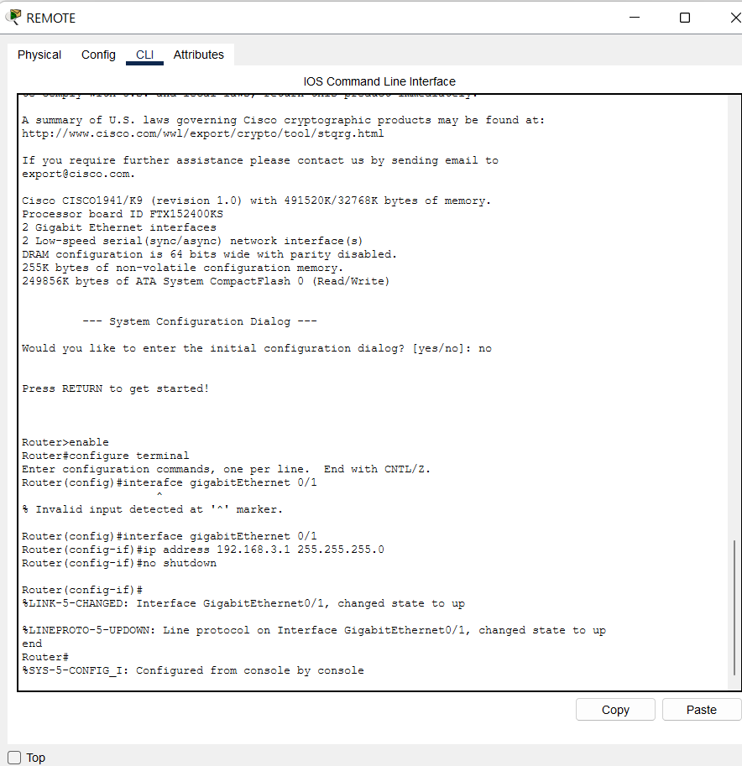
Preparation and Guideline for Lab 5
Open REMOTE router
Double-click the REMOTE router on the right.
Select the CLI tab.
Press Enter if necessary.
Enter the following commands.
enable
configure terminal
interface gigabitEthernet 0/1
ip address 192.168.3.1 255.255.255.0
no shutdown
end

Slide 50
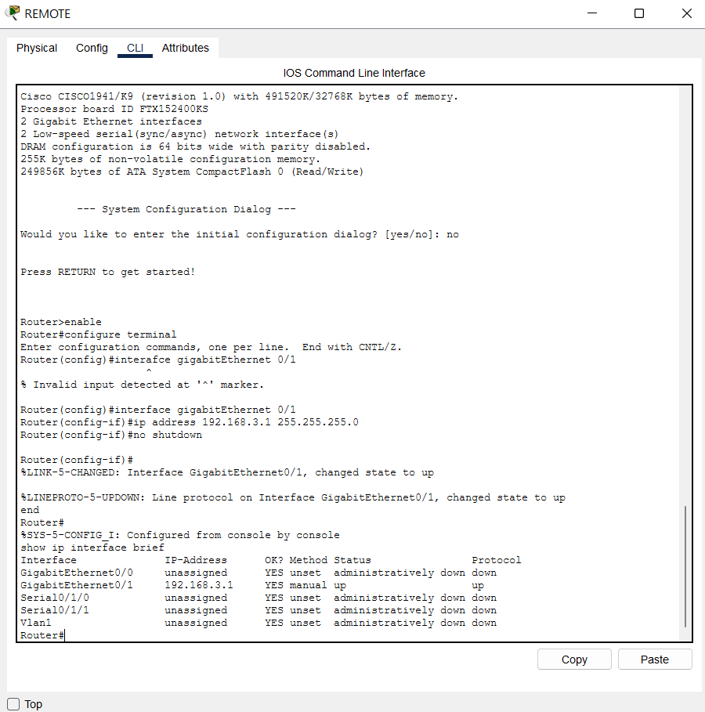
Preparation and Guideline for Lab 5
Check the connection
Still on REMOTE → CLI, enter:
show ip interface brief
Look for:
GigabitEthernet0/1 192.168.3.1 YES manual up up
If you see up/up, the REMOTE ↔ S3 connection is operational.
The red indicators should turn green after Packet Tracer processes the interface change.

Slide 51
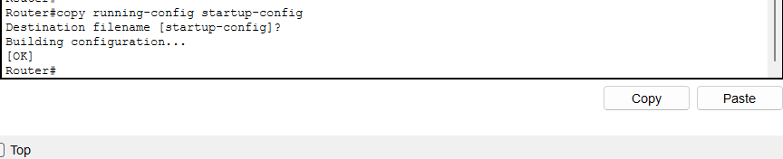
Preparation and Guideline for Lab 5
Save your configuration
Enter:
copy running-config startup-config
Press Enter when prompted for the filename.

Slide 52
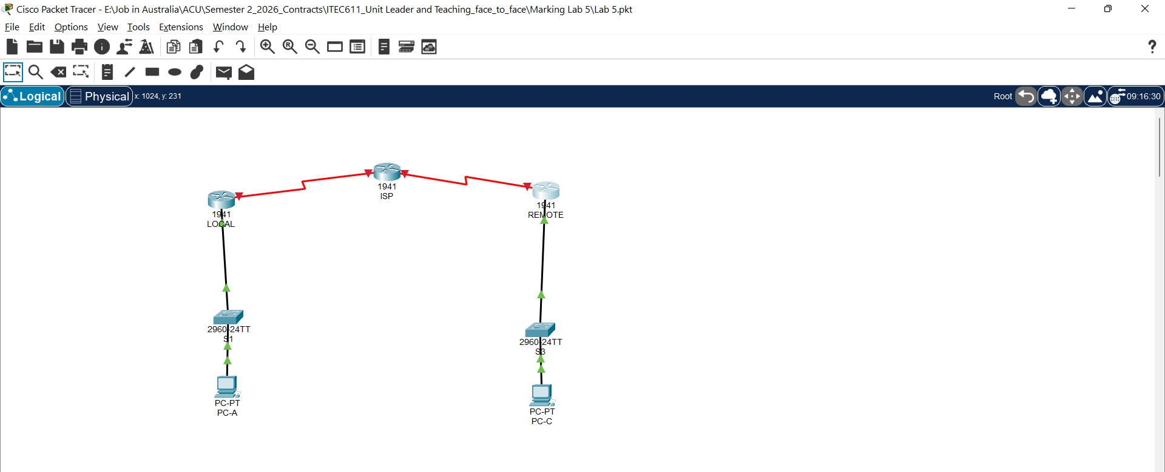
Preparation and Guideline for Lab 5
Colour | Meaning
Green | Connection is operational
Red | Connection is down or an interface is disabled
Amber | Port may be transitioning or blocked by a switching protocol

Slide 53
Preparation and Guideline for Lab 5
Connection | Status
LOCAL ↔ S1 | Working
S1 ↔ PC-A | Working
REMOTE ↔ S3 | Working
S3 ↔ PC-C | Working
LOCAL ↔ ISP | Not operational
ISP ↔ REMOTE | Not operational
Important: Green does not yet guarantee that the PCs can communicate across the network. We still need IP addressing, routing and connectivity testing.

Slide 54
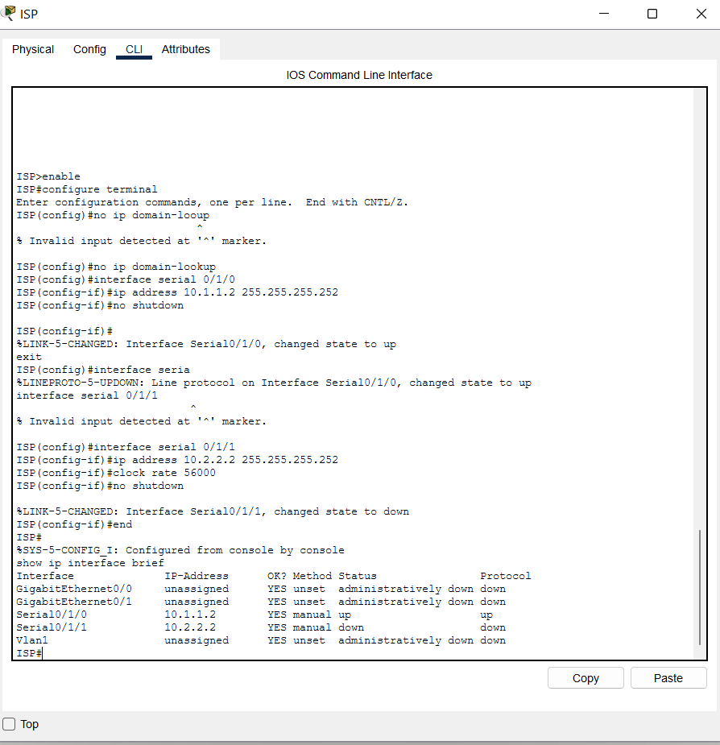
Preparation and Guideline for Lab 5
Next step: Configure the ISP router
Now we need to bring the two red serial WAN links online.
ISP router
Open ISP → CLI and enter:
enable
configure terminal
no ip domain-lookup
interface serial 0/1/0
ip address 10.1.1.2 255.255.255.252
no shutdown
exit
interface serial 0/1/1
ip address 10.2.2.2 255.255.255.252
clock rate 56000
no shutdown
end
show ip interface brief

Slide 55
Preparation and Guideline for Lab 5
The clock rate 56000 command belongs on ISP's Serial0/1/1 because that is the DCE end of the ISP–REMOTE connection in your topology.
Afterwards, configure REMOTE's Serial0/1/1 with 10.2.2.1/30 and no shutdown, if you have not already done so.
Our next goal: Make both red WAN connections green. Once that happens, we can configure EIGRP, test ping and tracert, and complete the troubleshooting activities in Lab 5.

Slide 56
Preparation and Guideline for Lab 5
Correct the REMOTE router
Open REMOTE → CLI.
First check the available interfaces:
enable
show ip interface brief
Assuming its connected serial interface is Serial0/1/1, enter:
configure terminal
hostname REMOTE
no ip domain-lookup

Slide 57
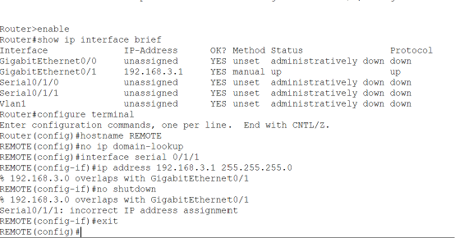
Preparation and Guideline for Lab 5
interface serial 0/1/1
ip address 10.2.2.1 255.255.255.252
no shutdown
exit
interface gigabitEthernet 0/1
ip address 192.168.3.1 255.255.255.0
no shutdown
exit

Slide 58
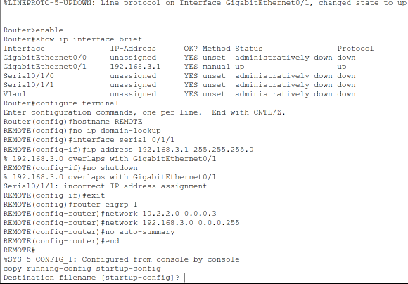
Preparation and Guideline for Lab 5
router eigrp 1
network 10.2.2.0 0.0.0.3
network 192.168.3.0 0.0.0.255
no auto-summary
end
copy running-config startup-config
Enter

Slide 59
Preparation and Guideline for Lab 5
If you face any issue, Check the connections
Make sure the cables match
Assuming all three routers have their serial modules in the same slot, the connections should be:
Source | Interface | Destination | Interface
LOCAL | Serial0/1/0 (DCE) | ISP | Serial0/1/0
ISP | Serial0/1/1 (DCE) | REMOTE | Serial0/1/1
LOCAL | GigabitEthernet0/1 | S1 | FastEthernet0/5
REMOTE | GigabitEthernet0/1 | S3 | FastEthernet0/5

Slide 60
Preparation and Guideline for Lab 5
Verify your work
On LOCAL, ISP and REMOTE, run:
show ip interface brief
For the connected serial interfaces, the desired result is:
Interface | IP address | Status | Protocol
LOCAL Serial0/1/0 | 10.1.1.1 | up | up
ISP Serial0/1/0 | 10.1.1.2 | up | up
ISP Serial0/1/1 | 10.2.2.2 | up | up
REMOTE Serial0/1/1 | 10.2.2.1 | up | up

Slide 61
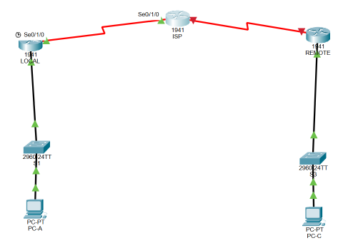
Preparation and Guideline for Lab 5
Understanding Serial Clocking
A serial WAN link needs timing information so that devices can exchange bits correctly.
On the LOCAL router:
My topology shows:
LOCAL → ISP: Serial 0/1/0 on LOCAL and Serial 0/1/0 on ISP.
ISP → REMOTE: Serial 0/1/1 on ISP and Serial 0/1/1 on REMOTE.

Slide 62
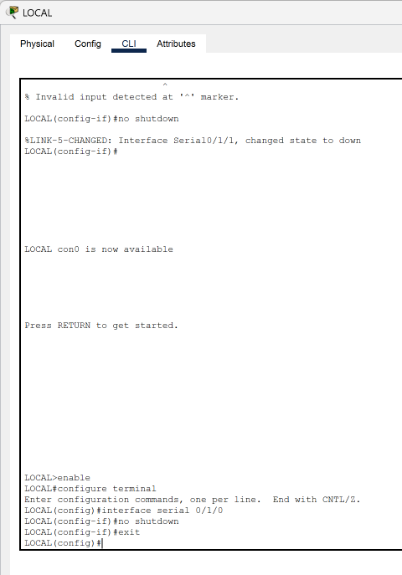
Preparation and Guideline for Lab 5
Task 1: Understanding Serial Clocking (Updated)
A serial WAN link requires clocking information to synchronise data transmission between routers.
In this topology, three Cisco 1941 routers are connected:
LOCAL ←→ ISP ←→ REMOTE
Step 1: Configure the LOCAL router
Open LOCAL → CLI and enter:
enable
configure terminal
interface serial 0/1/0
no shutdown
exit

Slide 63
Preparation and Guideline for Lab 5
On the ISP router, configure the DCE interface connecting to REMOTE:
clock rate 56000 configures serial clocking on the DCE end.
no shutdown administratively enables the interface.
If LOCAL is the DCE end, also enter clock rate 56000 under that interface.

Slide 64

Preparation and Guideline for Lab 5
Step 2: Configure the ISP router
Open ISP → CLI.
For the connection between ISP and LOCAL:
enable
configure terminal
interface serial 0/1/0
no shutdown
exit

Slide 65
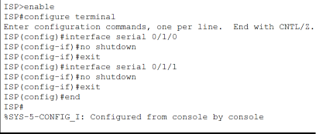
Preparation and Guideline for Lab 5
For the connection between ISP and REMOTE:
interface serial 0/1/1
no shutdown
exit
end
If ISP is the DCE end of either connection,
configure clock rate
56000 on that DCE
interface.

Slide 66
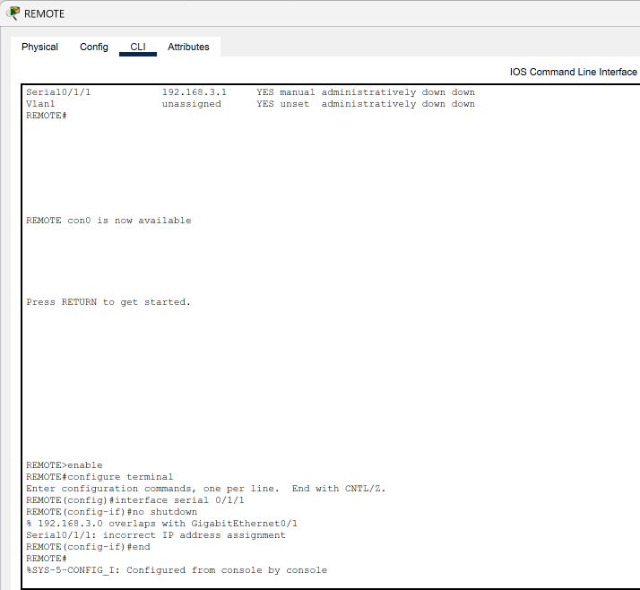
Preparation and Guideline for Lab 5
Step 3: Configure the REMOTE router
Open REMOTE → CLI and enter:
enable
configure terminal
interface serial 0/1/1
no shutdown
end
If REMOTE is the DCE end, configure clock rate 56000 on its serial interface.

Slide 67
Preparation and Guideline for Lab 5
Step 4: Identify the DCE interfaces
The clock rate command must be applied only to the DCE end of each serial connection.
On each router, enter:
show controllers serial 0/1/0
For the ISP and REMOTE connection, use:
show controllers serial 0/1/1
Look for DCE or DTE in the output. Apply the clock rate on whichever interface reports DCE.

Slide 68
Preparation and Guideline for Lab 5
Verify the connections
You need to check all three routers separately in Cisco Packet Tracer.
Follow these steps:
LOCAL router: Click LOCAL → CLI, then enter:
enable
show ip interface brief
ISP router: Click ISP → CLI, then enter:
enable
show ip interface brief
REMOTE router: Click REMOTE → CLI, then enter:
enable
show ip interface brief

Slide 69
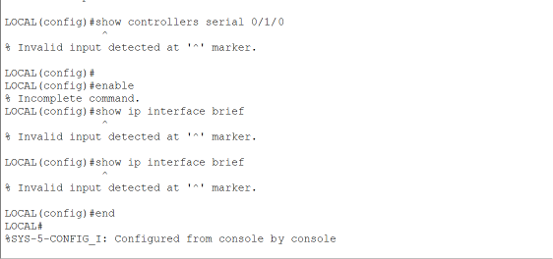
Preparation and Guideline for Lab 5
If you see an error, type: end
It is currently in configuration mode, shown by:
LOCAL(config)#
The command show ip interface brief normally runs in privileged EXEC mode, shown by:
LOCAL#
Step 1: Exit configuration mode
At LOCAL(config)#, type:
end

Slide 70
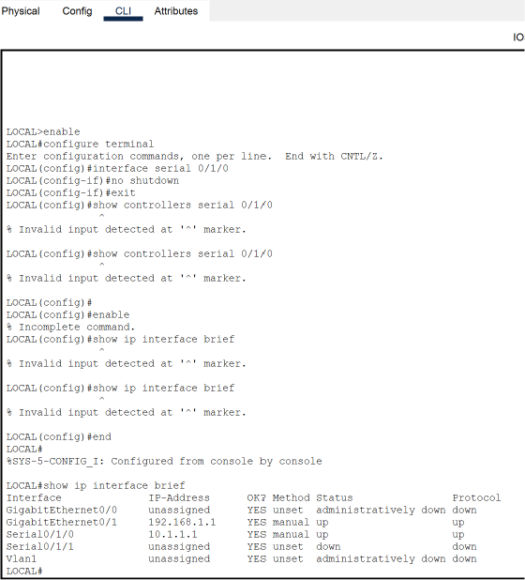
Preparation and Guideline for Lab 5
You should now see:
LOCAL#
Step 2: Check the interfaces
Now type:
show ip interface brief
This should work correctly.

Slide 71
Preparation and Guideline for Lab 5
Alternative (without exiting configuration mode)
You can also enter:
do show ip interface brief
This works directly from LOCAL(config)#.

Slide 72
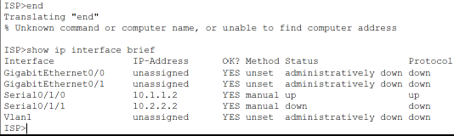
Preparation and Guideline for Lab 5
Repeat for ISP and REMOTE
On each router, enter:
end
show ip interface brief
This means:
LOCAL ↔ ISP: Working at the interface level.
ISP ↔ REMOTE: Not working yet.

Slide 73
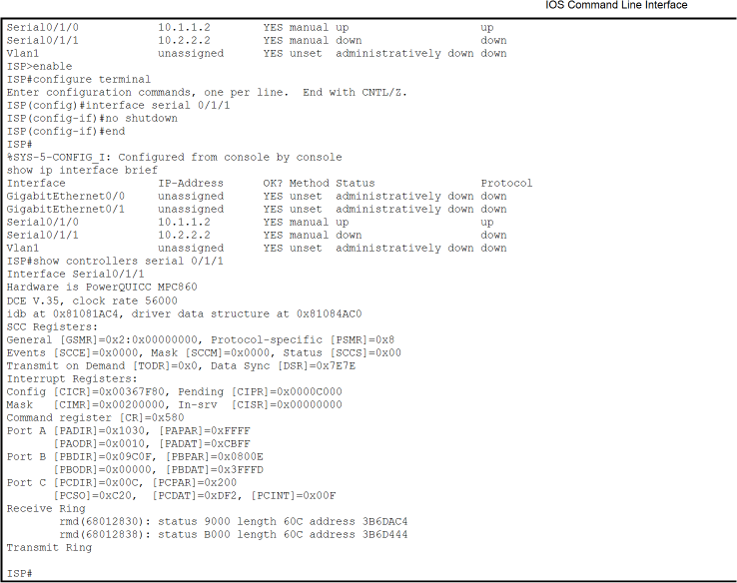
Preparation and Guideline for Lab 5
What to do now on ISP
We are already at ISP>. Enter these commands:
enable
configure terminal
interface serial 0/1/1
no shutdown
end
show ip interface brief

Slide 74
Preparation and Guideline for Lab 5
Serial0/1/0: up/up — working correctly.
Serial0/1/1: down/down — not working yet.
DCE detected: DCE V.35, clock rate 56000
Important: Your ISP
Serial0/1/1 is already
configured as DCE with
a clock rate of 56000.
You do not need to
configure the clock rate
again.

Slide 75
Preparation and Guideline for Lab 5
Go to the REMOTE router
Click REMOTE in Packet Tracer.
Select CLI.
Enter:
enable
configure terminal
interface serial 0/1/1
no ip address
ip address 10.2.2.1 255.255.255.252
no shutdown
end

Slide 76
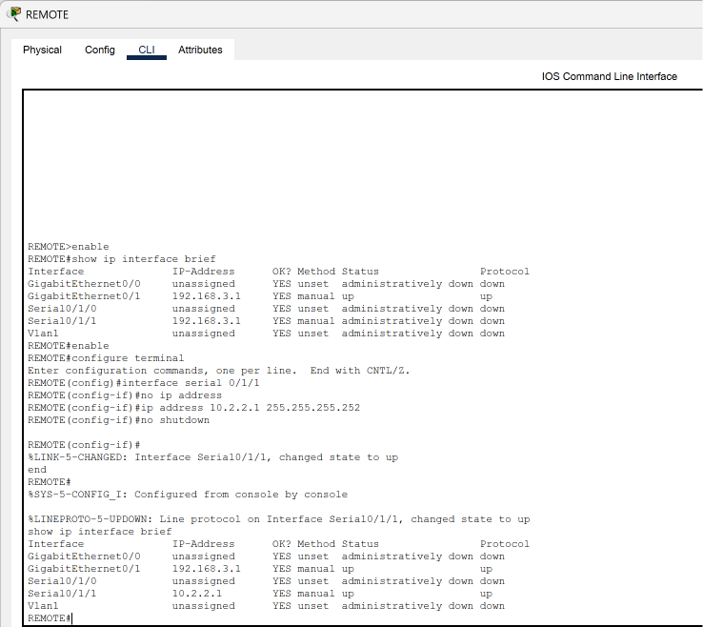
Preparation and Guideline for Lab 5
Verify REMOTE
Enter:
show ip interface brief
The message Line protocol on Interface Serial0/1/1, changed state to up confirms that the serial connection has become operational.

Slide 77
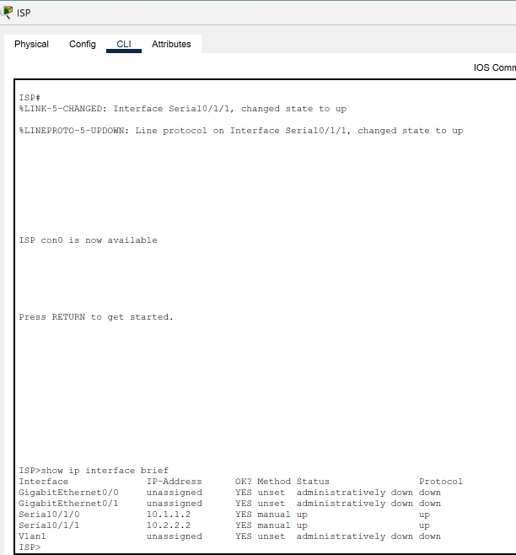
Preparation and Guideline for Lab 5
Verify ISP
Click ISP → CLI.
Enter:
show ip interface brief

Slide 78
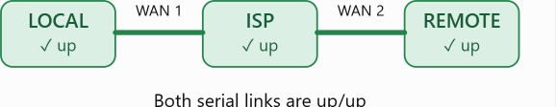
Preparation and Guideline for Lab 5
Interface | IP address | Status | Result
Serial0/1/0 | 10.1.1.2 | up/up | Working
Serial0/1/1 | 10.2.2.2 | up/up | Working
GigabitEthernet0/0 | Unassigned | administratively down | Not used
GigabitEthernet0/1 | Unassigned | administratively down | Not used
My ISP router is now correctly configured at the interface level.

Slide 79
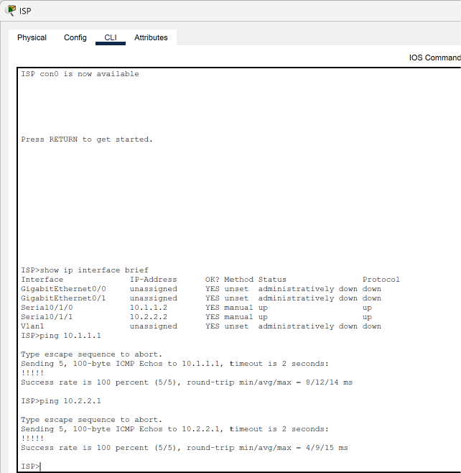
Preparation and Guideline for Lab 5
Test both connections from ISP
Click ISP → CLI.
At ISP> or ISP#, enter:
ping 10.1.1.1
ping 10.2.2.1
Expected result for each:
Success rate is 100 percent (5/5)
A first attempt of 80% (4/5) can also occur.

Slide 80
Preparation and Guideline for Lab 5
Both ISP connections are working perfectly.
Our screenshot confirms that both ping tests were successful.
Test | Result | Status
ISP → LOCAL (10.1.1.1) | 100% (5/5) | Passed
ISP → REMOTE (10.2.2.1) | 100% (5/5) | Passed
ISP Serial0/1/0 | up/up | Working
ISP Serial0/1/1 | up/up | Working

Slide 81
Preparation and Guideline for Lab 5
What does 100% (5/5) mean?
5 packets sent: The ISP router sent five test packets.
5 packets received: All five packets received successful replies.
0% packet loss: No packets were lost during these tests.
This confirms that ISP can communicate with both LOCAL and REMOTE over their serial connections.

Slide 82
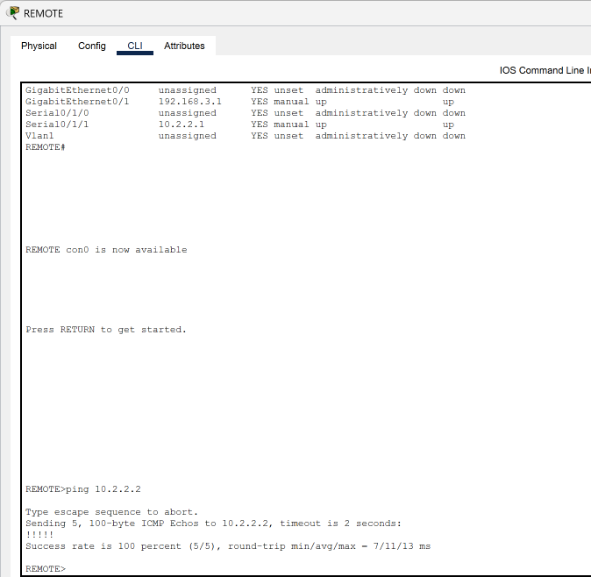
Preparation and Guideline for Lab 5
Next step: Final REMOTE test
Click REMOTE → CLI and enter: ping 10.2.2.2

Slide 83
Preparation and Guideline for Lab 5
Our REMOTE screenshot confirms:
Success rate is 100 percent (5/5)
This means REMOTE successfully communicated with ISP at 10.2.2.2. Combined with your earlier ISP tests, Task 1: Understanding Serial Clocking is complete.

Slide 84
Preparation and Guideline for Lab 5
Connection | Test result | Status
LOCAL ↔ ISP | 100% ping success | Passed
ISP ↔ REMOTE | 100% ping success | Passed
REMOTE → ISP | 100% ping success | Passed
Serial clocking | DCE clock rate 56000 verified on ISP–REMOTE link | Passed

Slide 85
Preparation and Guideline for Lab 5
What did students learn from Task 1?
Learning outcome: Students understand how serial WAN connections operate and how to configure, troubleshoot, and verify connectivity between routers.
Concept | What students learned
Serial WAN | How routers communicate across point-to-point WAN connections
DCE and DTE | DCE provides clocking; DTE receives timing information
Clock rate | How clock rate 56000 configures timing on the DCE interface
IP addressing | Each end of a serial connection requires a compatible, unique IP address
Interface activation | no shutdown enables an interface
Troubleshooting | How to identify up/up, down/down, and administratively down
Verification | How to use show ip interface brief, show controllers serial, and ping

Slide 86
Preparation and Guideline for Lab 5
What is the main lesson?
Students should understand that a physically connected cable does not automatically mean the network connection is operational.
For successful serial communication, the routers need correct interface configuration, compatible IP addressing, active interfaces, and appropriate clocking on the DCE side.
Your practical exercise demonstrated these concepts, including identifying and correcting an incorrect IP address on REMOTE.

Slide 87
Preparation and Guideline for Lab 5
What is not completed yet?
Although the serial WAN connections are working, this does not automatically mean PC-A can communicate with PC-C.
That requires appropriate routing between the two LAN networks, along with correct PC addressing and default gateways.
Conclusion: Task 1 is complete. You can now move to the next lab task, which may involve static routing or another WAN configuration exercise, depending on your lab instructions.

Slide 88

Preparation and Guideline for Lab 5
Task 2: Configure PC IP Addresses
Live demonstration
On PC-A:
Double-click PC-A.
Select Desktop → IP Configuration.
Choose Static.
Enter the values below.

Slide 89

Preparation and Guideline for Lab 5
PC-A – Static IPv4 configuration
IP address
192.168.1.3
Subnet mask
255.255.255.0
Default gateway
192.168.1.1
DNS server
Not required

Slide 90

Preparation and Guideline for Lab 5
On PC-C: Repeat the process with IP address 192.168.3.3, subnet mask 255.255.255.0 and default gateway 192.168.3.1.

Slide 91
Preparation and Guideline for Lab 5
Why: Each PC needs a unique IP address. Its default gateway tells the PC where to send traffic destined for another network.
Question: What happens if PC-A has the correct IP address but the wrong default gateway?

Slide 92
Preparation and Guideline for Lab 5
Task 3: Configure the LOCAL Router
Open LOCAL → CLI and enter:
enable
configure terminal
hostname LOCAL
no ip domain-lookup
interface serial 0/1/0
ip address 10.1.1.1 255.255.255.252
clock rate 56000
no shutdown
exit

Slide 93
Preparation and Guideline for Lab 5
interface gigabitEthernet 0/1
ip address 192.168.1.1 255.255.255.0
no shutdown
exit
router eigrp 1
network 10.1.1.0 0.0.0.3
network 192.168.1.0 0.0.0.255
no auto-summary
end
copy running-config startup-config
When prompted with Destination filename [startup-config]?, press Enter.

Slide 94
Preparation and Guideline for Lab 5
Explanation
hostname LOCAL – Names the router.
no ip domain-lookup – Prevents DNS lookup delays caused by mistyped commands.
interface serial 0/1/0 – Selects the WAN interface connected to ISP.
clock rate 56000 – Provides timing on the DCE end of the serial connection.
interface gigabitEthernet 0/1 – Selects the LAN interface connected to switch S1.
ip address – Assigns an IP address and subnet mask.
no shutdown – Enables the interface.
router eigrp 1 – Enables EIGRP dynamic routing.
network – Identifies connected networks that participate in EIGRP.
no auto-summary – Disables automatic classful route summarisation.
copy running-config startup-config – Saves the configuration.

Slide 95
Preparation and Guideline for Lab 5
Why EIGRP? EIGRP allows LOCAL to learn routes to remote networks automatically rather than requiring manually configured static routes.

Slide 96
Preparation and Guideline for Lab 5
Task 3: Configure the ISP and REMOTE Routers
Live demonstration
ISP router – CLI
enable
configure terminal
hostname ISP
no ip domain-lookup
interface serial 0/1/0
ip address 10.1.1.2 255.255.255.252
no shutdown
exit

Slide 97

Preparation and Guideline for Lab 5
interface serial 0/1/1
ip address 10.2.2.2 255.255.255.252
clock rate 56000
no shutdown
exit
router eigrp 1
network 10.1.1.0 0.0.0.3
network 10.2.2.0 0.0.0.3
no auto-summary
end
copy running-config startup-config

Slide 98

Preparation and Guideline for Lab 5
REMOTE router – CLI
enable
configure terminal
hostname REMOTE
no ip domain-lookup
interface serial 0/1/1
ip address 10.2.2.1 255.255.255.252
no shutdown
exit
interface gigabitEthernet 0/1
ip address 192.168.3.1 255.255.255.0
no shutdown
exit

Slide 99
Preparation and Guideline for Lab 5
router eigrp 1
network 10.2.2.0 0.0.0.3
network 192.168.3.0 0.0.0.255
no auto-summary
end
copy running-config startup-config

Slide 100
Preparation and Guideline for Lab 5
Explanation
Serial0/1/1 – Connects REMOTE to ISP.
10.2.2.1/30 – Assigns the REMOTE WAN address.
GigabitEthernet0/1 – Connects REMOTE to switch S3.
192.168.3.1/24 – Configures the default gateway for the REMOTE LAN.
router eigrp 1 – Allows REMOTE to exchange routing information with ISP.
Why? The REMOTE router connects the destination LAN to the WAN and provides a path back to the LOCAL network.

Slide 101

Preparation and Guideline for Lab 5
Verify Router Configuration and Connectivity
After configuring all three routers, verify their interfaces and routing information.
On each router, enter:
enable
show ip interface brief
show ip route
show ip eigrp neighbors

Slide 102

Preparation and Guideline for Lab 5
Connectivity testing
On LOCAL:
ping 10.1.1.2
ping 10.2.2.1
ping 192.168.3.1
On REMOTE:
ping 10.2.2.2
ping 10.1.1.1
ping 192.168.1.1
Successful responses indicate that the routers can communicate across the configured network paths.

Slide 103

Preparation and Guideline for Lab 5
On REMOTE:
ping 10.2.2.2
ping 10.1.1.1
ping 192.168.1.1
Successful responses indicate that the routers can communicate across the configured network paths.

Slide 104
Preparation and Guideline for Lab 5
Why: The ISP forwards packets between the two serial networks. The REMOTE router connects the WAN to the destination LAN.
Verification: On each router, run:
show ip interface brief
show ip route
show ip eigrp neighbors
Look for up/up interfaces, learned routes marked D, and established EIGRP neighbours.

Slide 105


Preparation and Guideline for Lab 5
There are two important distinctions:
Red serial cables do not necessarily indicate a failed connection. In Packet Tracer, the cable itself is displayed red for a serial connection. Check the link-status triangles or show ip interface brief to determine whether the interface is operational.

Slide 106
Preparation and Guideline for Lab 5
The clock rate command must be applied only to the DCE end. Your screenshots show LOCAL Serial0/1/0 and ISP Serial0/1/1 as the DCE interfaces, consistent with the commands above.

Slide 107
Preparation and Guideline for Lab 5
What job-ready skills are we developing?
Network Configuration: IPv4 addressing, default gateways, router and switch configuration.
Routing and WAN Technologies: EIGRP, serial WAN connections and routing tables.
Network Diagnostics: Ping, traceroute, packet loss, latency and TTL analysis.
Troubleshooting: Fault isolation, Cisco IOS commands and connectivity restoration.
Professional Skills: Analytical thinking, problem-solving, technical documentation and communication.

Slide 108
Preparation and Guideline for Lab 5
What jobs can you apply for?
These foundational skills are relevant to entry-level positions such as:
IT Support Technician / Help Desk Analyst
Junior Network Engineer
Network Operations Centre (NOC) Technician
Network Support Technician
Junior Network Administrator
IT Infrastructure Support Officer
Job search keywords: IT Support, Junior Network Engineer, NOC Technician, Network Support, Cisco, TCP/IP, Network Troubleshooting.

Slide 109
Preparation and Guideline for Lab 5
We have completed selected tasks together. You now understand how to build a multi-router WAN topology, configure IPv4 addressing and EIGRP routing, and use Cisco Packet Tracer to verify network connectivity. You have developed the foundational knowledge required to complete the remaining extended ping, traceroute, fault diagnosis, network repair and reflection activities independently.

Slide 110
Preparation and Guideline for Lab 5
Career support: I am happy to support your job applications, including providing guidance on your CV, cover letter, LinkedIn profile and interview preparation. These practical skills can help you demonstrate your technical capabilities when applying for entry-level IT and networking roles.

Slide 111
Submission of Labs & Assessments
These guidelines are designed to support your learning and help you apply necessary techniques effectively. Please do the remaining task and follow the instructions based on Canvas. If you have any questions, feel free to ask—I’m happy to help!

Slide 112
Preparation and Guideline for Lab 5
You are encouraged to discuss concepts and work alongside classmates, but your final work, screenshots, explanations, and submission must reflect your own understanding and work.

Slide 113
Preparation and Guideline for Lab 5
Do not share completed submissions or copy another student’s work. Each student must submit individually through Canvas, and submissions may be reviewed using Turnitin and other academic integrity processes.
Make sure you can run your program, explain your work, and demonstrate your understanding.

Slide 114

Let’s Answer Your Questions
Live during class – Ask directly during sessions.
Canvas Inbox – For structured academic queries.
Email – For formal communications or attachments.
Canvas Discussion Forum – Everyone can see and learn from your question.

Slide 115

Thank You
Happy Learning and Bright Futures Ahead!
Stay Connected:
linkedin.com/in/farshid-keivanian
github.com/FarshidKeivanian
Education is the most powerful weapon you can use to change the world. — Nelson Mandela

